Slide 1

Liver Cirrhosis Prediction Using Machine Learning
Presented by Divya Sai Sree Chintala
Hawk Id: A20561001
Group No : 12

Slide 2

Problem Statement
Liver cirrhosis is a widespread problem, especially in North America due to high alcohol intake. Our goal is to predict liver cirrhosis in patients based on their lifestyle and health conditions.
Cirrhosis is a late stage of scarring (fibrosis) of the liver caused by many forms of liver diseases and conditions, such as hepatitis and chronic alcoholism.

Slide 3
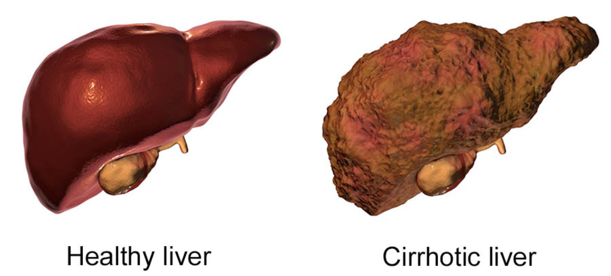

Slide 4

Data Collection
Objective: Mayo Clinic conducted a trial on Primary Biliary Cirrhosis (PBC) of the liver from 1974 to 1984.
Participants: 424 PBC patients eligible for a placebo-controlled D-penicillamine drug trial.
Details:
First 312 cases participated in the randomized trial with comprehensive data.
Additional 112 cases didn't join the trial but consented for basic measurements and survival
106 cases from this group, along with the 312 participants, are included in the dataset.
Background Reading: Clinical context in Fleming and Harrington's "Counting Processes and Survival Analysis" (1991). Additional insights in Dickson et al.'s "Hepatology" (1989) and Markus et al.'s "N Eng J of Med" (1989).

Slide 5
Data Description
ID
unique identifier
N_Days
number of days between registration and the earlier of death, transplantation, or study analysis time in July 1986
Status
status of the patient C (censored), CL (censored due to liver tx), or D (death)
Drug
type of drug D-penicillamine or placebo
Age
age in [days]
Sex
M (male) or F (female)
Ascites
presence of ascites N (No) or Y (Yes). Fluid in Abdomen
Hepatomegaly
presence of hepatomegaly N (No) or Y (Yes). Liver Enlargement
Spiders
presence of spiders N (No) or Y (Yes). Small Blood Vessels
Edema
presence of edema N, S, Y. Swelling caused by fluid trapped in Blood tissue in any part of body

Slide 6
Data Description
Bilirubin (Compound)
serum bilirubin in [mg/dl]
Cholesterol
serum cholesterol in [mg/dl]
Albumin (Protein)
albumin in [gm/dl]
Copper
urine copper in [ug/day]
Alk_Phos
alkaline phosphatase in [U/liter]
SGOT (Alcohol Ratio)
SGOT in [U/ml]
Triglycerides (Fat)
triglycerides in [mg/dl]
Platelets
platelets per cubic [ml/1000]
Prothrombin (Protein)
prothrombin time in seconds [s]
Stage
histologic stage of disease (1, 2, 3, or 4)

Slide 7


s
Data Preprocessing
For Missing Values :-
Numerical Features :- Mean imputation to avoid skewing in the presence of outliers.
Categorical Features :- Imputed the most frequent class (mode).
For Transformation :-
Categorical values has transformed into numerical values to make them compatible for model.
Converted the Age values from days to years.
Checked for the outliers and further removed them from modeling.
Numerical variables we can perform normalization to remove the outlier values.
Ex:- Ascites :- Yes —> 1
Ascites :- No -—> 0

Slide 8
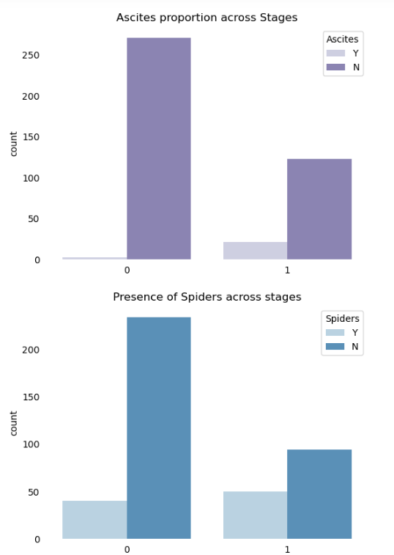
Exploratory Data Analysis (EDA)
Before building the model, we will perform EDA to gain insights into the data.
This will involve analyzing the relationships between features and the target variable, identifying patterns, and visualizing the data.

Slide 9

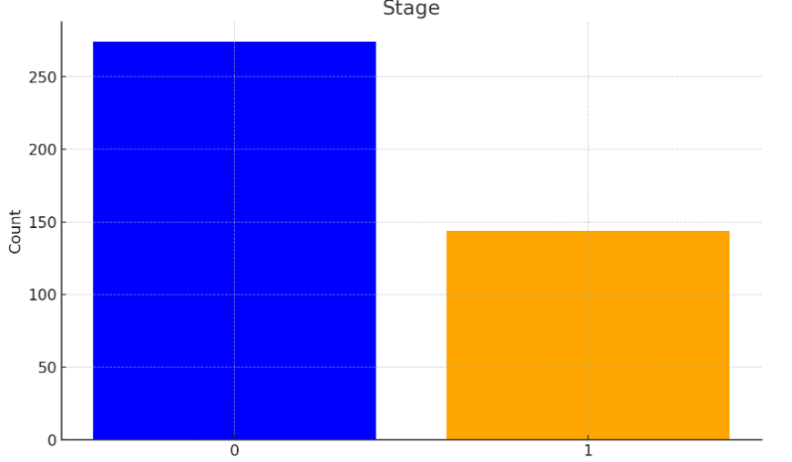
SMOTE Technique
Following the preprocessing of the dataset, we have a total of 373 entries.
Of these, 246 are classified under Stage 0 and 127 under Stage 1.
To balance this imbalanced dataset, SMOTE Technique has been used.

Slide 10
Model Selection and Training
We have split the data in 70% for Training and 30% for Testing.
Creating a baseline model using Logistic Regression. Later, explored the tree-based models, which are more interpretable and robust to outliers.
Models :-
Logistic Regression (Base Line)
Decision Tree
Random Forest (Best Performed)
Voting Classifier Model ( Random Forest , SVM, Decision Tree)

Slide 11

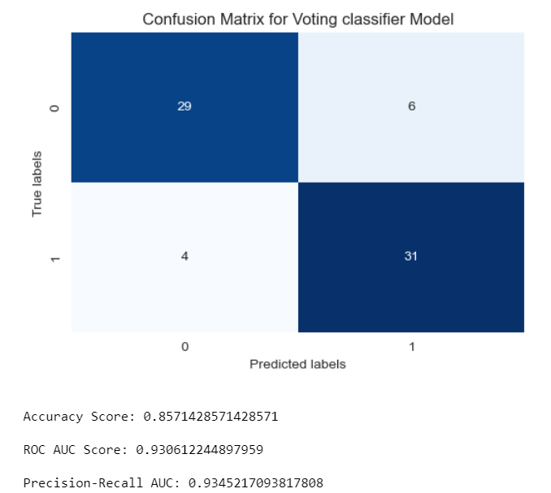
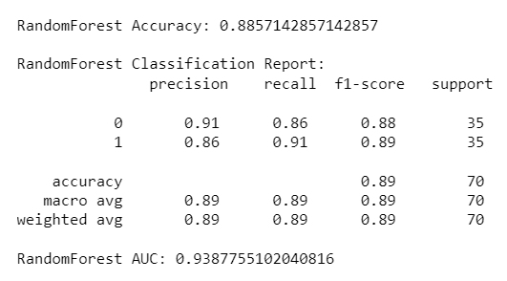
Model Evaluation and Interpretation
We will evaluate the performance of the models using cross-validation and confusion matrix and assess their performance and robustness on the testing data.
The best performed model was Random Forest Classifier with 88% Accuracy which is good with 400 Data Points .

Slide 12
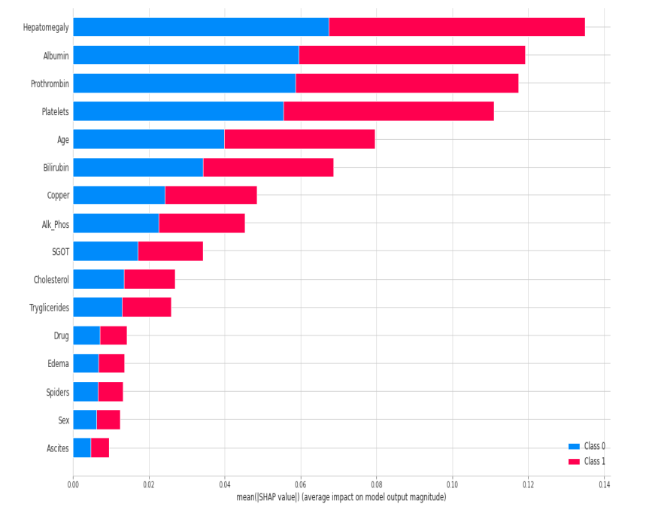
SHAP Values

Slide 13

References
Throughout the project, various research papers and resources have been referenced to ensure accurate analysis and interpretation. The references include Fleming and Harrington's "Counting Processes and Survival Analysis" (1991), Dickson et al.'s "Hepatology" (1989), Markus et al.'s "N Eng J of Med" (1989), and more.

Slide 14

Q&A
We will open the floor for any questions and provide answers to further clarify the project.

